Slide 1

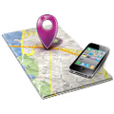
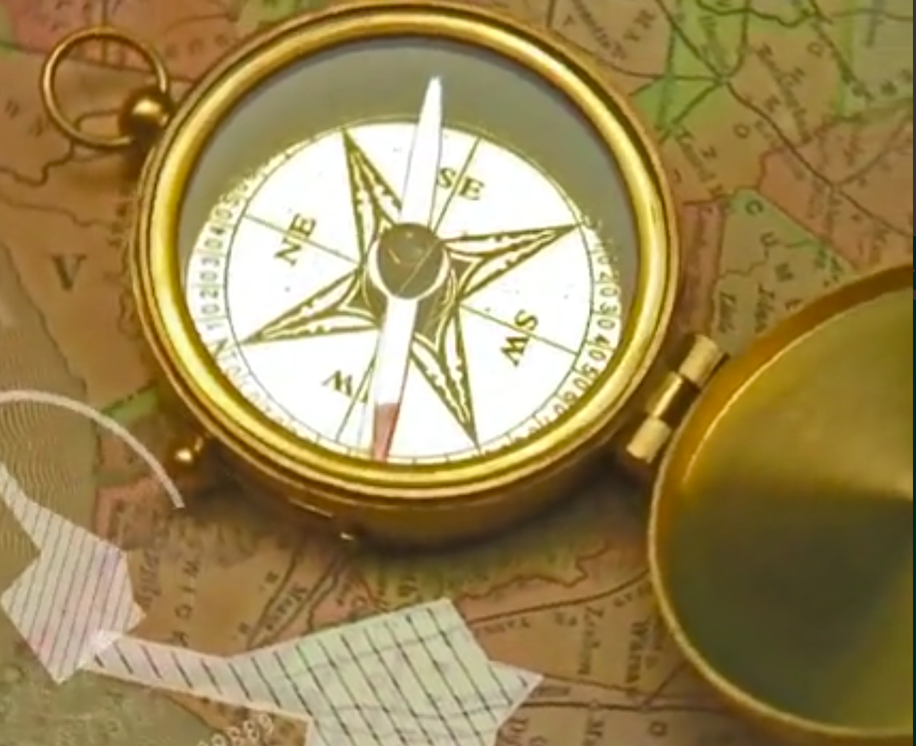

CLOUD
Positioning system,
Map matching,
Advanced data
analysis
Magnetometer
Magnetic
measurement
Accelerometer
Inertial
measurement
Gyroscope
Wi-Fi
Wi-Fi/Bluetooth
Bluetooth

Slide 2
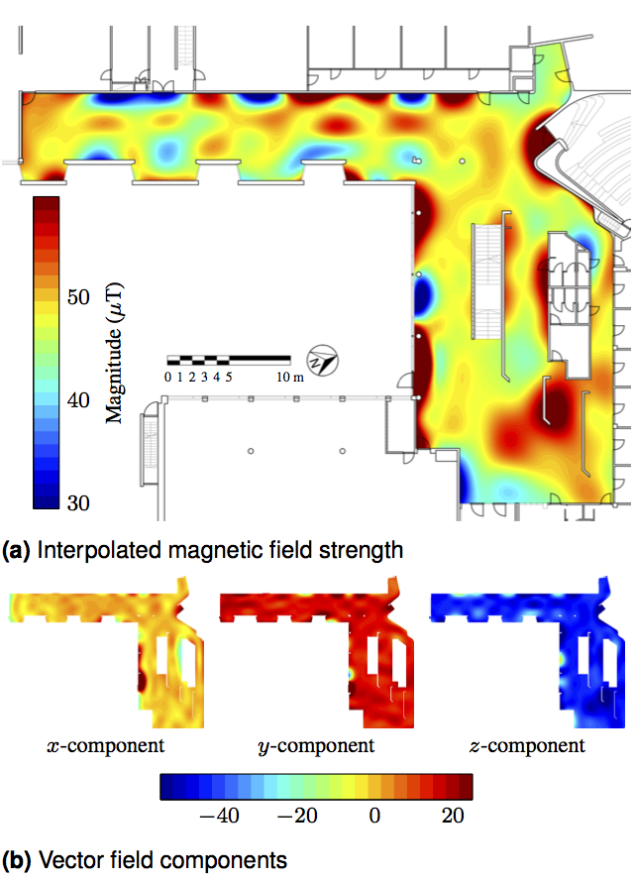


Slide 3
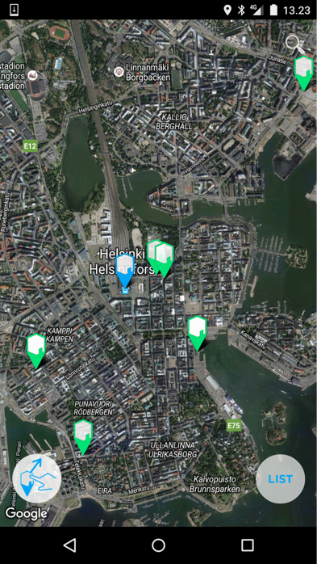
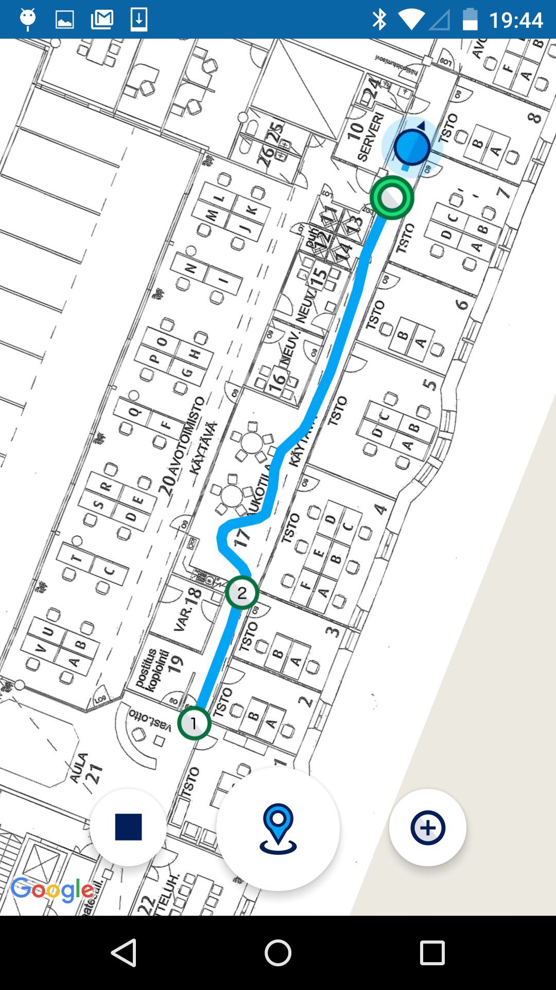

Slide 4
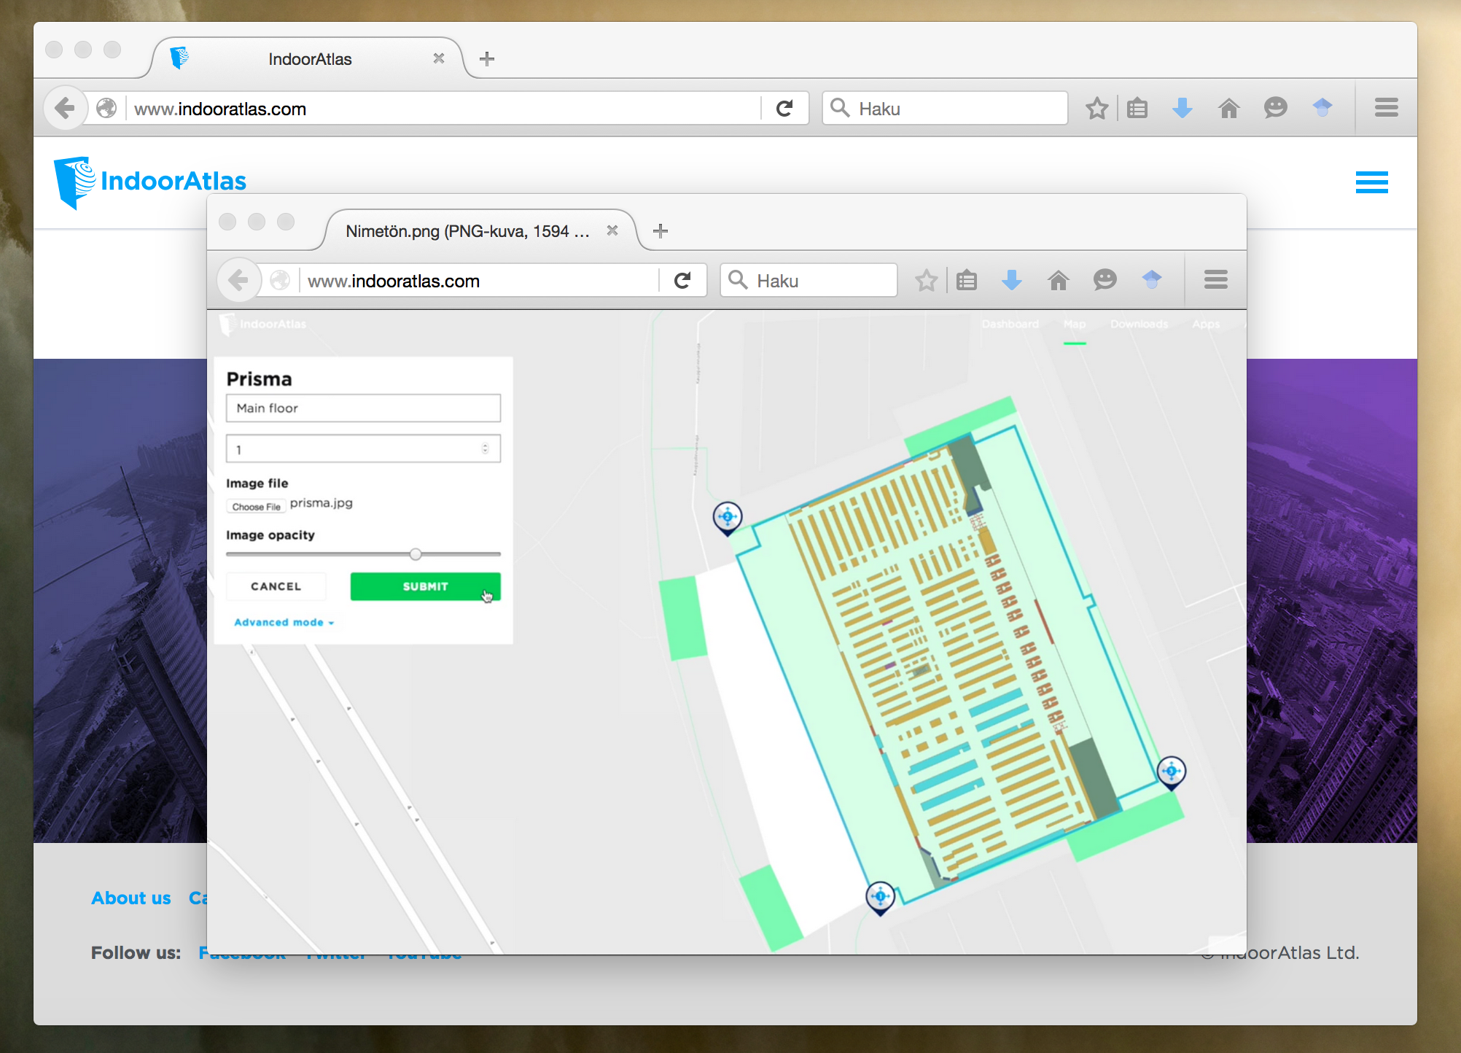

Slide 5
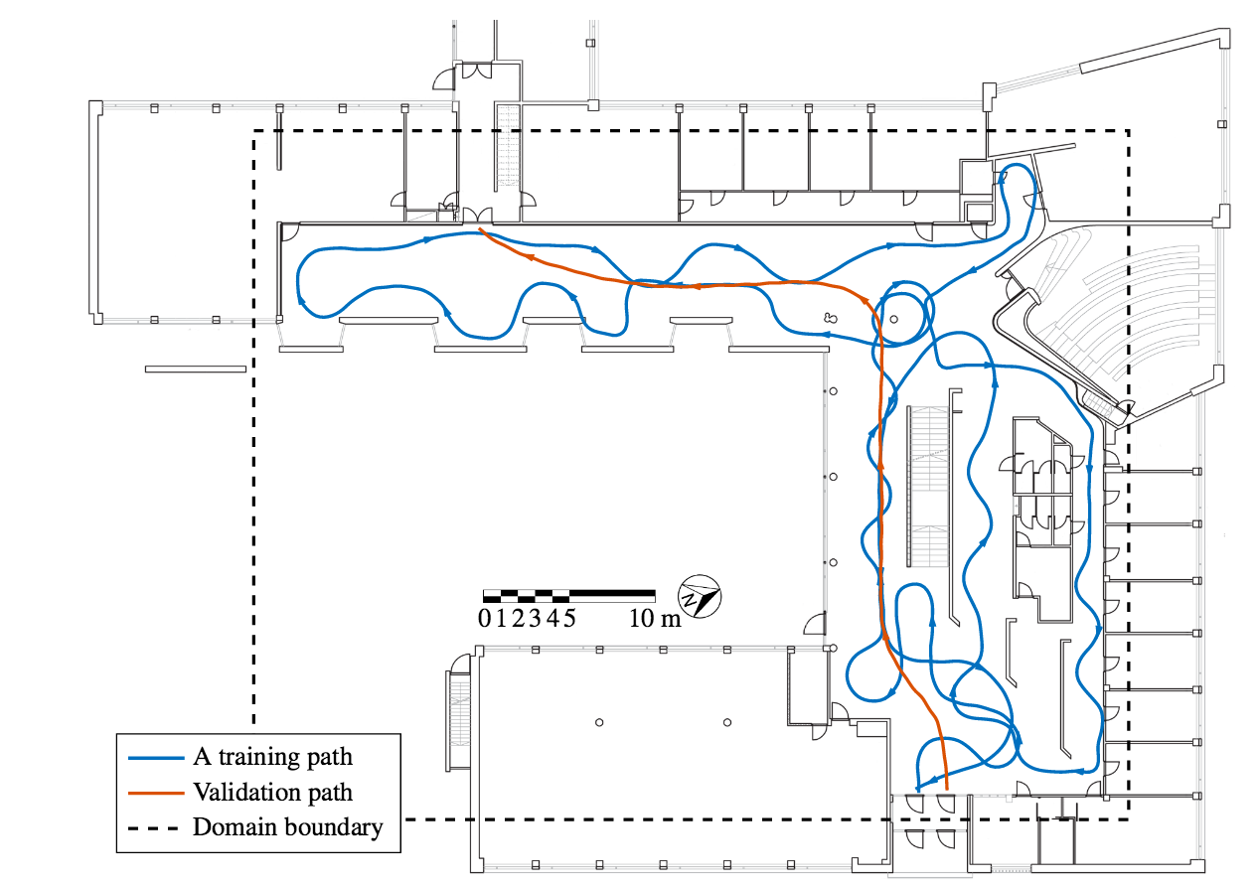
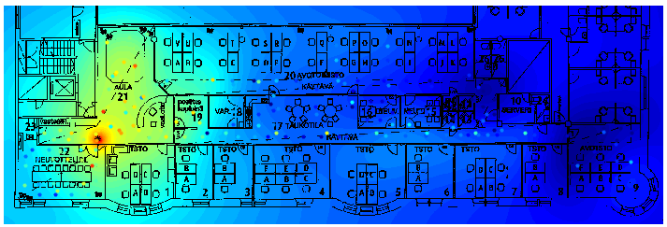

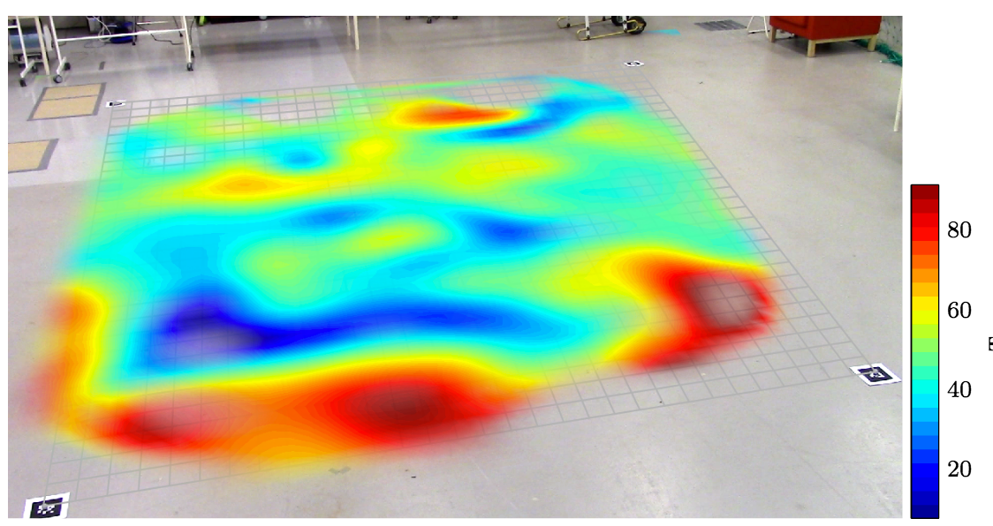

Slide 6
Android or iPhone
AWS / Azure Cloud
Positioning
Algorithms,
Data analysis
algorithms,
Map generation
Magnetic & PDR data
Floor maps and position
Floor map
Fingerprints
Positioning data
Fingerprint
map DB
Positioning
session DB
Floor map
image DB
Raw mapping
data DB
Cassandra

Slide 7
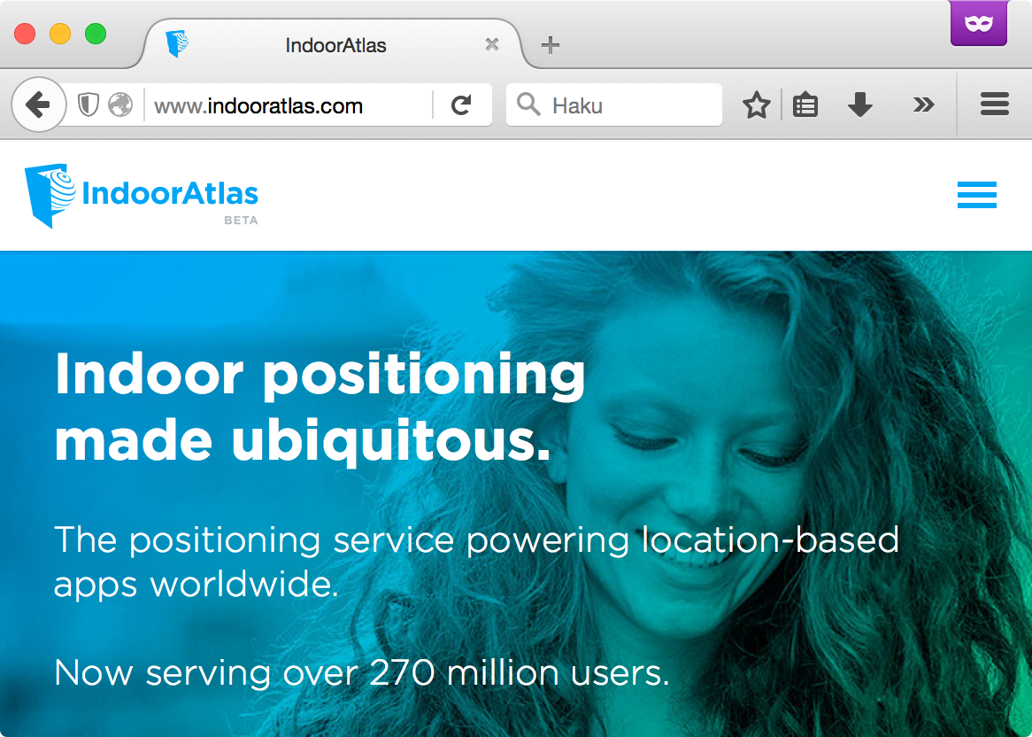
Web browser
Android phone
AWS / Azure Cloud
Positioning
Algorithms,
Data analysis
algorithms,
Map generation
Sensor data
Fingerprint map
Floor map
Raw sensor data
Fingerprint
map DB
Positioning
session DB
Floor map
image DB
Raw mapping
data DB
Cassandra

Slide 8
Web browser
Android phone
AWS / Azure Cloud
Magnetic,PDR
& sensor data
Positioning
Algorithms,
Data analysis
algorithms
Automatic
map healing,
SLAM
Floor maps and position
Floor
map
Fingerprints/maps
Positioning
data
Raw sensor data
IDA World
map DB
Positioning
session DB
Floor map
image DB
Raw mapping
data DB
Cassandra

